Slide 1

Clap Switch Using Arduino
Group 2 Presentation

Slide 2




THE TEAM
CHRISTIAN RAPAL
BRECHY ROSALES
ELLA MAE CORTES
JOSE LUWIEZ SERGIO

Slide 3
CONTENTS OF OUR PRESENTATION
00
04
Flow Chart
Introduction
01
05
Significance
Assembly Program
02
06
Block Diagram
Live Prototype
03
Schematic Circuit
07
Recommendations
02
02

Slide 4
INTRODUCTION
Our project is a Clap Switched Lamp programmed in Arduino. This circuit is used to make the light ON through a clap sound but it can work through any kind of same pitch sound. The essential components used to build this project are electric condenser mic as a sound sensor. The main function of this device is to change the energy of sound to electrical.

Slide 5
PROJECT SIGNIFICANCE

Slide 6
PROJECT SIGNIFICANCE
The clap switch mechanism is helpful of the human daily activity like switch on/off the light in the home from any location. Switch on and off any peripherals inside the vehicles, activate the security cameras for the general purpose and the military purpose. Totally the advantages of clap switch circuit are Energy efficient system, normal cost and reliable circuit, High Accuracy and Complete elimination of manpower.

Slide 7
Block Diagram

Slide 8
BLOCK DIAGRAM
Notes:
A flip-flop is a bistable device, with inputs, that remains in a given state as long as power is applied and until input signals are applied to cause its output to change.

Slide 9
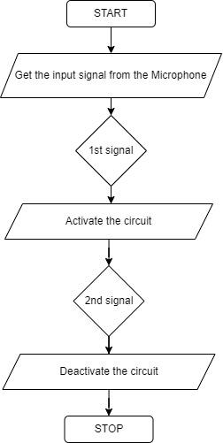
FLOW CHART

Slide 10
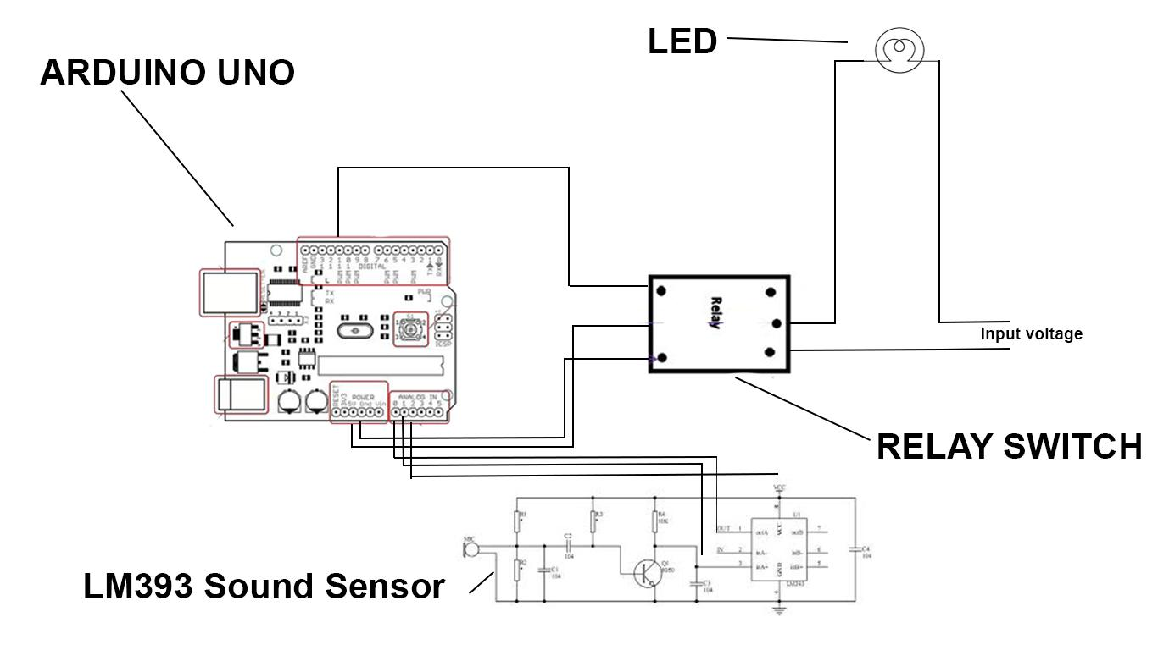
SCHEMATIC CIRCUIT

Slide 11
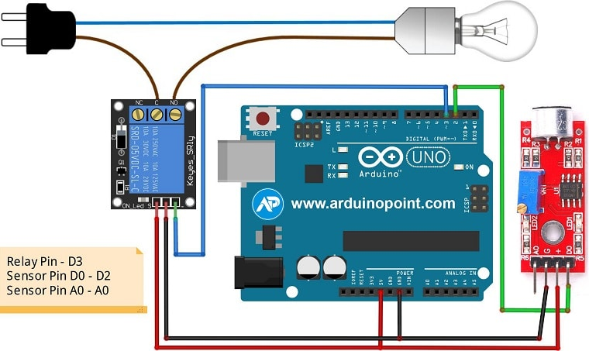
SCHEMATIC CIRCUIT

Slide 12
Assembly Program

Slide 13


Slide 14
LIVE PROTOTYPE

Slide 15
RECOMMENDATIONS
The lamp is controlled by clapping action but it can work through any kind of same pitch sound.
We recommend to adjust properly the Potentiometer of the sound sensor and a filter to avoid unnecessary pick-up of noise.

Slide 16
THANK YOU!

